Slide 1

SREENIDHI INSTITUTE OF SCIENCE AND TECHNOLOGY DEPARTMENT OF CSE
INTERNSHIP TITLE : FULL STACK DEVELOPMENT
DOMAIN: WEB DEVELOPMENT
STUDENT NAME 1 : Himanshu Bijja
ROLL NO : 23311A05P5
BRANCH SECTION: CSE-D
.

Slide 2
Internship-1 Seminar Contents
Introduction of Internship
Web Technologies 3.Tasks 4.Architecture
5. Lab Activity (Reports /Coding Output Screenshorts) 6.Summary/Conclusion of Internship
7.Thank you slide.
.

Slide 3
Introduction of Internship
I successfully completed a one-month virtual internship at CODSOFT in the domain of Full Stack Web Development.
During this internship, I gained valuable hands-on experience in designing, developing, and deploying responsive and user-friendly web applications.
The program provided a strong foundation in front-end technologies like HTML, CSS, and JavaScript, and introduced concepts of backend development and deployment.
Throughout the internship, I worked on three major modules, each focusing on building different types of web applications, which helped me enhance my technical knowledge, creativity, and problem-solving abilities.

Slide 4
About CODSOFT
CODSOFT is a leading training and internship platform dedicated to helping students and aspiring professionals gain practical, project-based experience in emerging technologies.
The organization provides opportunities to work on real-world projects that bridge the gap between academic knowledge and industry skills.
Through guided mentorship and structured tasks, CODSOFT enables learners to strengthen their frontend and backend development abilities, improve problem-solving skills, and build a solid foundation for their career in technology and software development.

Slide 5







Web Technoloeies used
Frontend:
<HTML>
<tiMe>\-JTML</1ig
TgE d HTMLI
Backend:
Version Control:
Tools:
Visual Studio Code

Slide 6
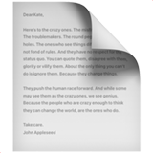


Modules / Tasks Overview
Task 1 – portfolio
Developed a fully responsive and interactive landing page using HTML, CSS, and JavaScript with a fixed navigation bar that changes style on scroll or hover.
•
•
•
Task 2 – landing page
Developed a responsive and interactive landing page using HTML, CSS, and JavaScript with a fixed navigation bar that changes style on scroll or hover with 3d animations.
•
•
Task 3 – calculator
Developed an advanced, fully interactive calculator , using HTML, CSS, and JavaScript. The interface includes a fully responsive layout, a glass-morphism display, and accurate button behavior with animations.

Slide 7
Module Highlight
•
1. Portfolio Website
•
Built a responsive personal portfolio using HTML and CSS to showcase my skills and projects.
•
Designed a clean and professional UI with easy navigation and organized sections.
•
2. Landing Page for an media agnecy
•
Developed a modern landing page with animations and a fixed navbar using HTML, CSS, and JavaScript.
•
Made the page fully responsive with smooth scrolling and interactive elements.
•
3. Calculator
•
Created a fully functional iPhone-style scientific calculator with themes, haptics, and animations.
•
Implemented scientific operations, memory features, and responsive UI using HTML, CSS, and JavaScript.

Slide 8
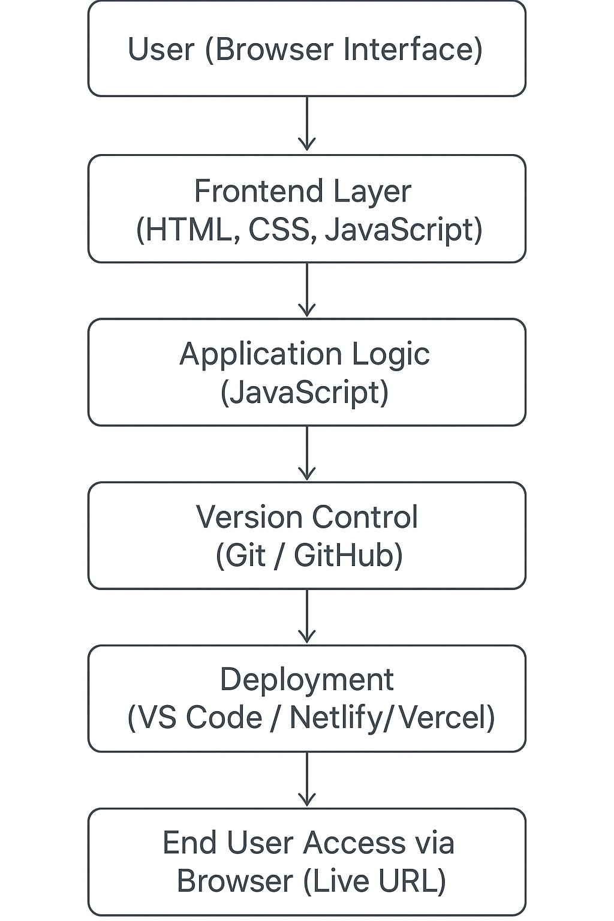
Architecture / Workflow
Workflow Explanation:
User interacts with the Frontend (HTML, CSS, JavaScript).
JavaScript handles dynamic logic, events, and UI updates.
Git & GitHub used for version control and collaborative management.
Project deployed using VS Code and hosted on Vercel / Netlify.
End User accesses the live application through a web browser.
•
•
•
•

Slide 9
Task 01 – Personal Portfolio Website
Objective:
To create a simple, clean, and professional portfolio website that showcases personal details, skills, and projects in a structured and responsive format.
Live GitHub
Key Features:
Clearly organized sections for About, Skills, Projects, and Contact.
Fully responsive design suitable for all screen sizes.
Simple navigation for easy browsing across all pages.
Clean UI created using HTML and CSS.
Professional presentation of profile details and resume.

Slide 10
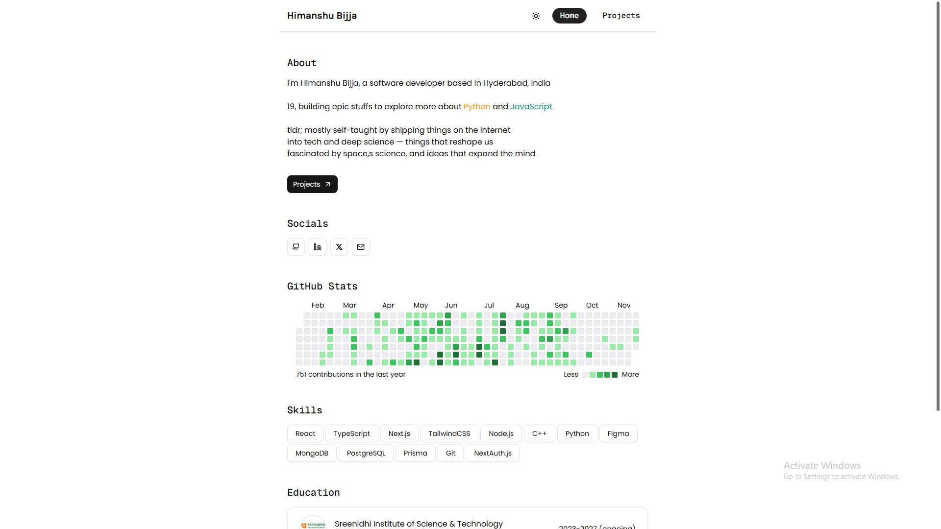
Personal Portfolio Website

Slide 11
Task 02 – Responsive Landing Page
Objective:
To design and develop a visually appealing, interactive, and fully responsive landing page that adapts to different screen sizes and enhances user experience.
Live GitHub
Key Features:
Fixed navigation bar visible on all pages.
Menu highlights or color changes on scroll or hover.
Mobile-friendly and compatible with all devices.
Clean layout using HTML, CSS, and JavaScript.
Smooth scrolling and user-friendly interface.

Slide 12
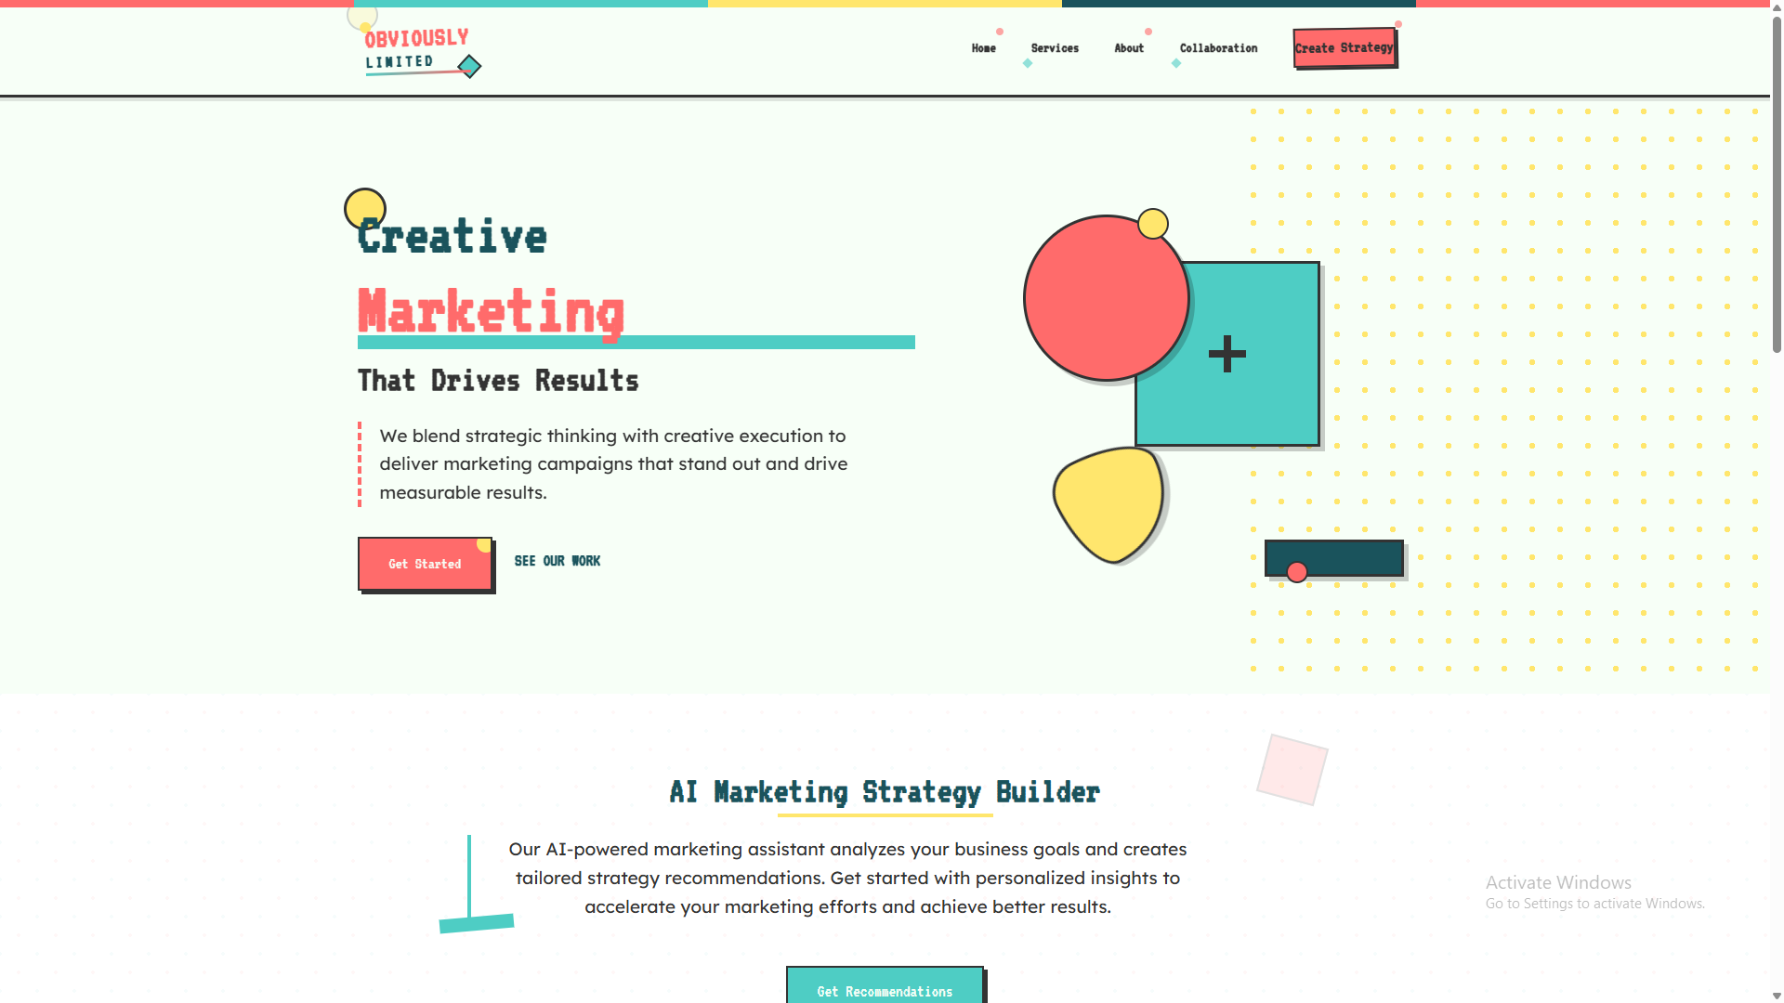
Responsive Landing Page

Slide 13
Task 03 – Calculator
Objective:
To develop a functional, interactive, and visually engaging scientific calculator with an iOS-inspired interface using HTML, CSS, and JavaScript.
Key Features:
Supports basic and advanced scientific operations (sin, cos, tan, log, x², xʸ, etc.).
Interactive button animations, ripple effects, and theme switching.
Haptic vibration and click-sound feedback for real-device feel.
Fully responsive layout with automatic scientific panel expansion.
Modern UI replicating iOS 17 calculator with Dynamic Island design.

Slide 14

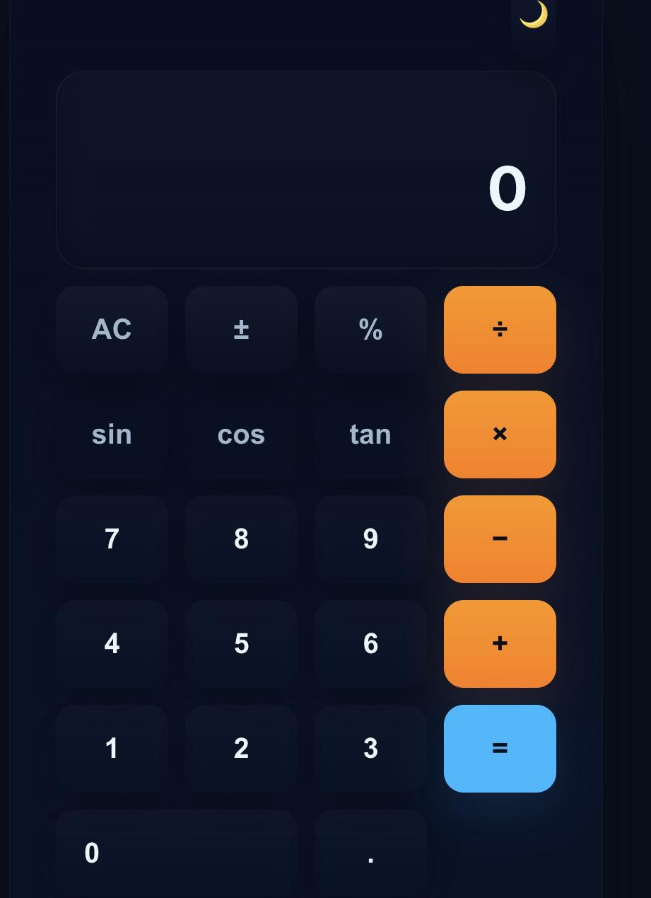
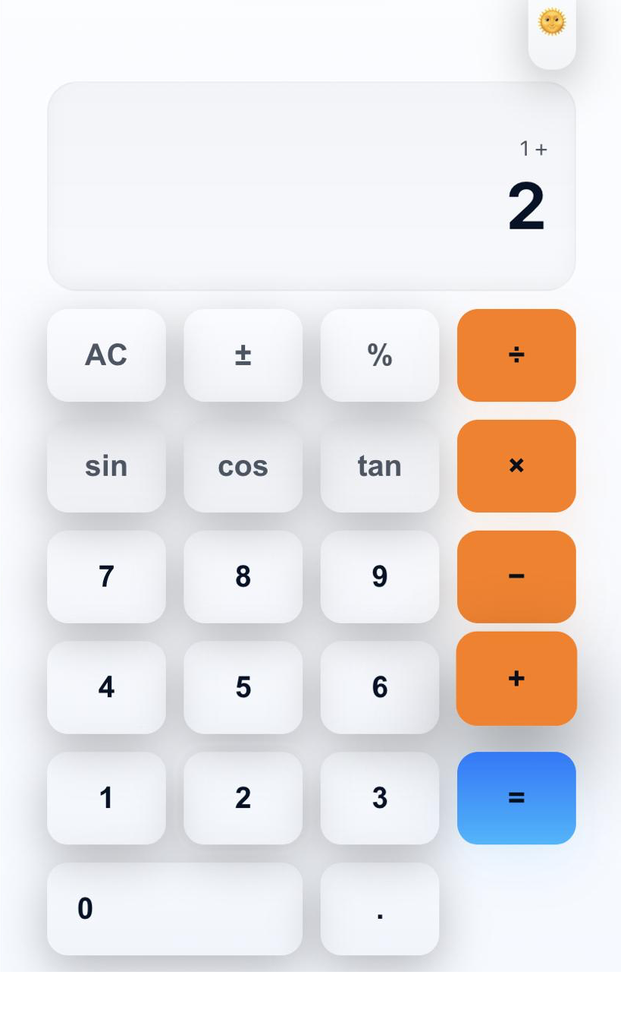
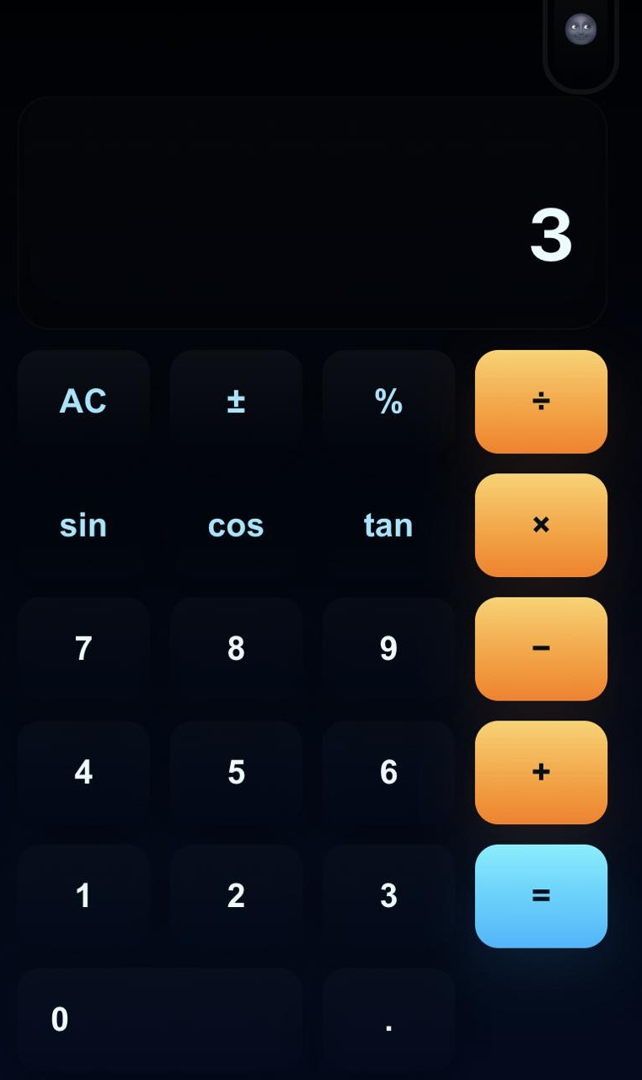
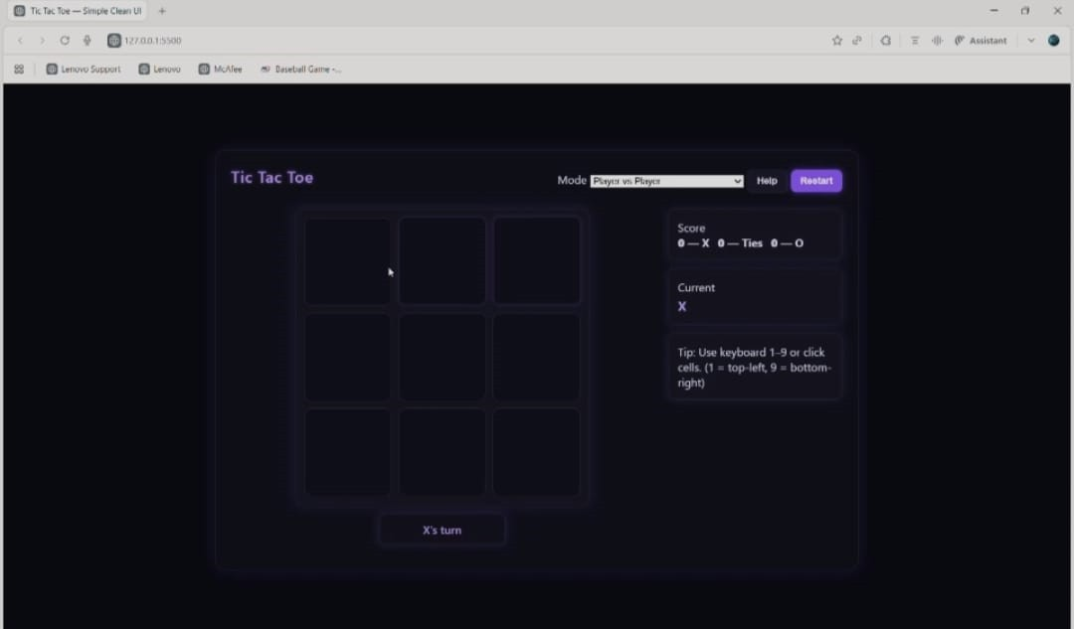
Calculator

Slide 15
SUMMARY
Enhanced technical knowledge in Full Stack Web Development.
Learned to build, test, and deploy responsive web apps.
Improved frontend design and logic implementation skills.
Gained valuable real-world project experience.

Slide 16
.
THANK YOU !
.

